Slide 1
Fitbit Activity Analysis
Understanding how activity metrics reflect effort, calories, and behavior
by Vladyslav Yakymchuk

Slide 2
Data Source & Context
Dataset: Fitbit Fitness Tracker Data Source: Kaggle (public dataset) License: CC0 (Public Domain – free to use by anyone)
Dataset Overview This dataset contains anonymized data collected from Fitbit users, including daily activity levels, sleep patterns, and basic health-related metrics. The data reflects real-world usage of consumer fitness trackers.
Data Scope
Time period: April – May 2016
Participants: 30 Fitbit users
Granularity: Daily-level records
Data Limitations
Small sample size
Data collected from consumer-grade devices
Users are not representative of the general population

Slide 3




Project Goals
MET (Metabolic Equivalent of Task) measures energy use relative to rest
Understand what drives calorie burn
Explore daily and weekly activity patterns
Examine the link between activity and sleep

Slide 4
What is MET?
MET (Metabolic Equivalent of Task) measures energy use relative to rest
1 MET = resting energy expenditure
Higher MET = higher physical effort
Used to standardize activity intensity

Slide 5
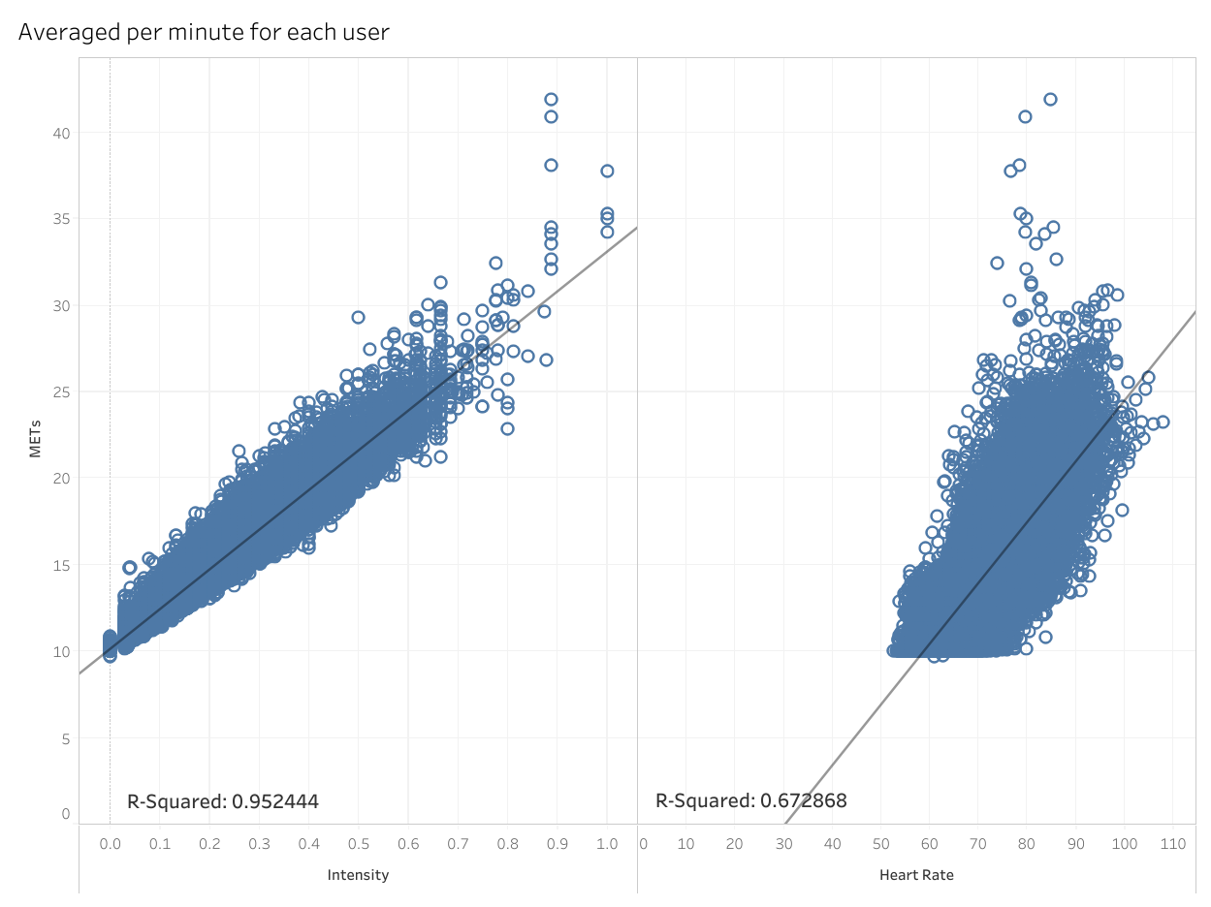
What determines METs?
Key result:
MET vs Intensity: very strong relationship (R² ≈ 0.95)
MET vs Heart Rate: weaker relationship (R² ≈ 0.67)
Interpretation:
Intensity almost fully determines MET
Heart rate reflects effort less directly

Slide 6
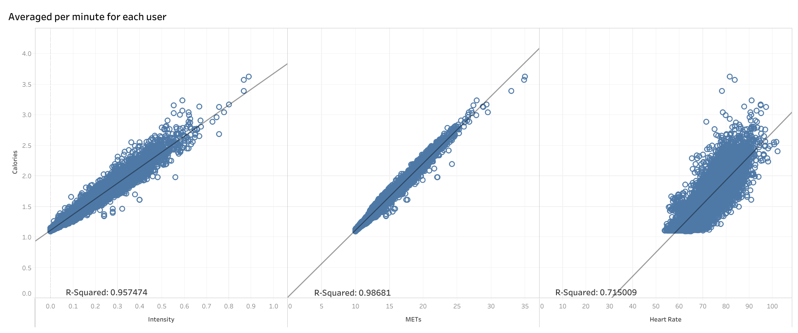
What Predicts Calories Burned?

Slide 7
What Predicts Calories Burned?
Results:
METs vs Calories: near‑perfect relationship (R² ≈ 0.99)
Intensity vs Calories: very strong (R² ≈ 0.96)
Heart Rate vs Calories: noticeably weaker (R² ≈ 0.72)
Conclusion:
Calories are fundamentally driven by METs and Intensity
Heart rate adds context but is less stable

Slide 8
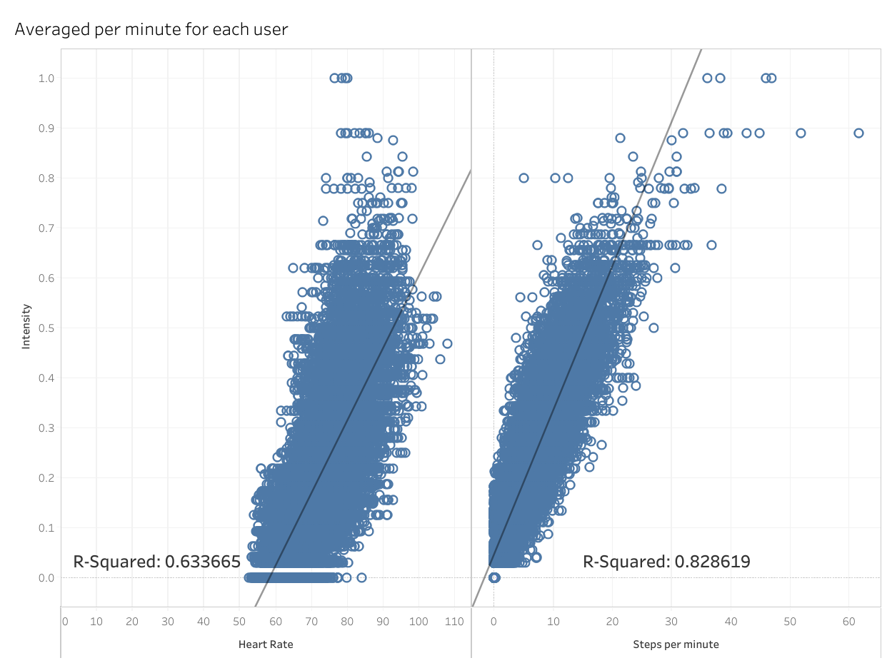
What determines Intensity?
Intensity vs Heart Rate: moderate relationship (R² ≈ 0.63)
Intensity vs Steps per Minute: strong relationship (R² ≈ 0.83)
Insight:
Intensity depends more on movement than physiology

Slide 9
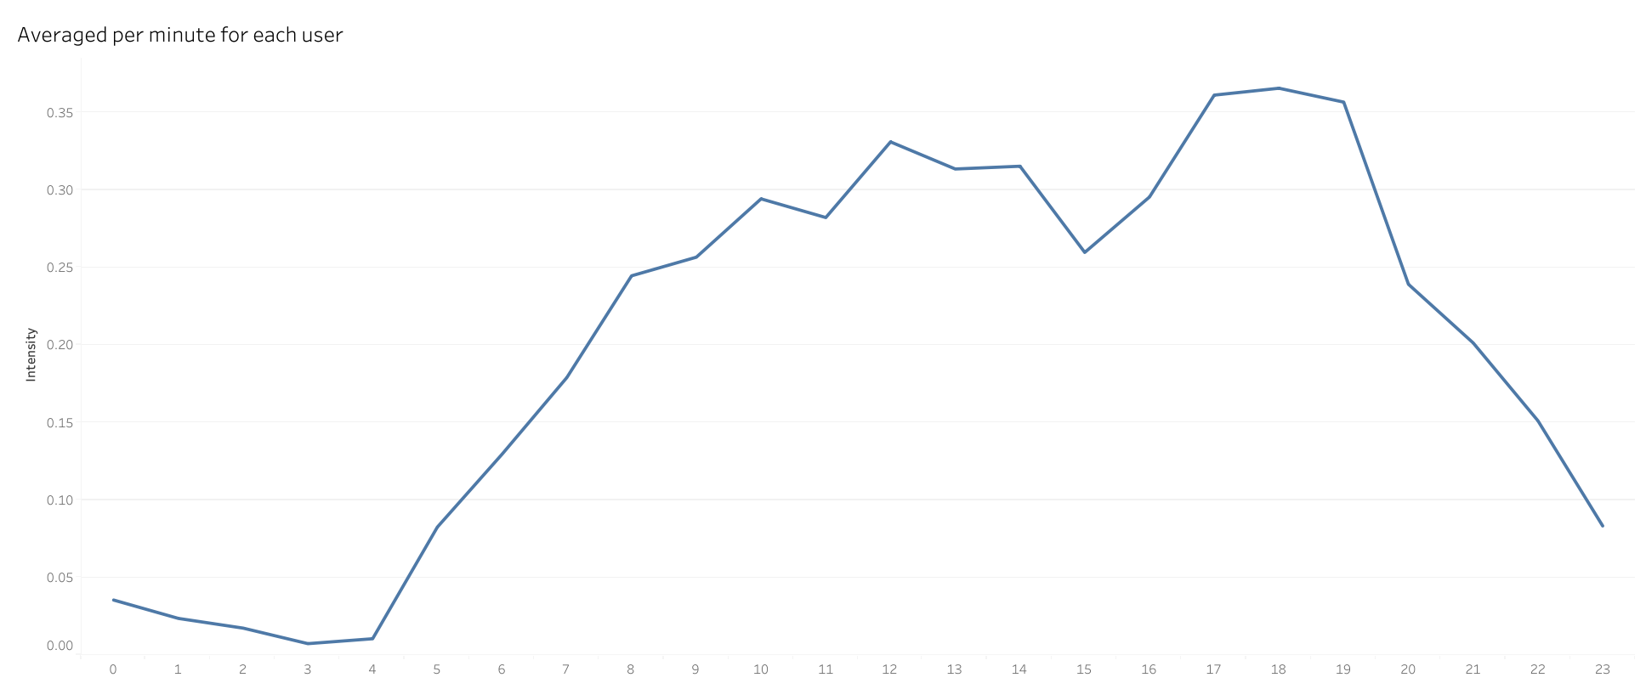
Activity by Time of Day

Slide 10
Activity by Time of Day
Lowest activity at night (sleep period)
Gradual rise in the morning
Peak activity around 5–6 p.m.
Decline in the evening
Interpretation:
Activity follows daily routines rather than random behavior

Slide 11
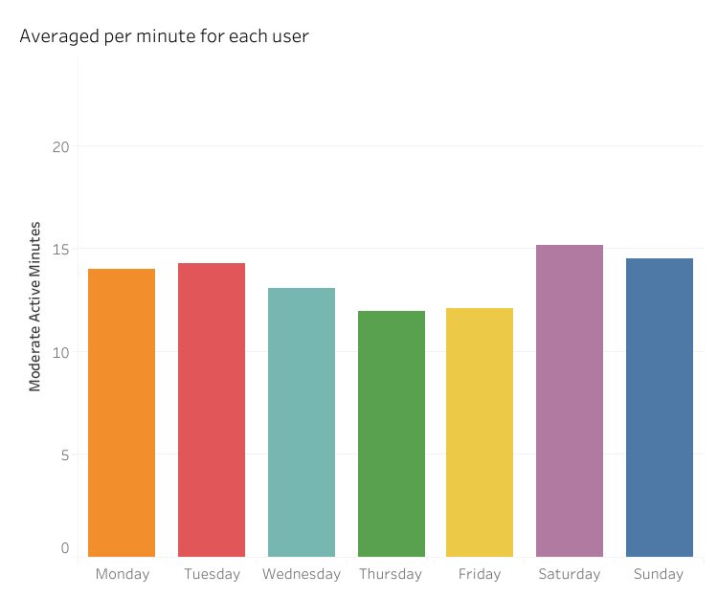
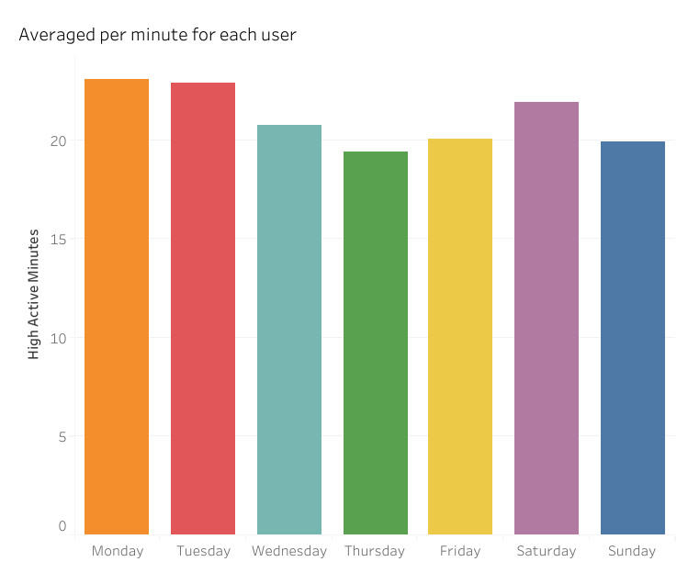
Activity by Day of Week

Slide 12
Activity by Day of Week
Activity levels are relatively stable
Slight increase on weekends (especially Saturday)
Lowest activity on Thursday and Friday
Insight:
Users maintain consistent baseline activity

Slide 13
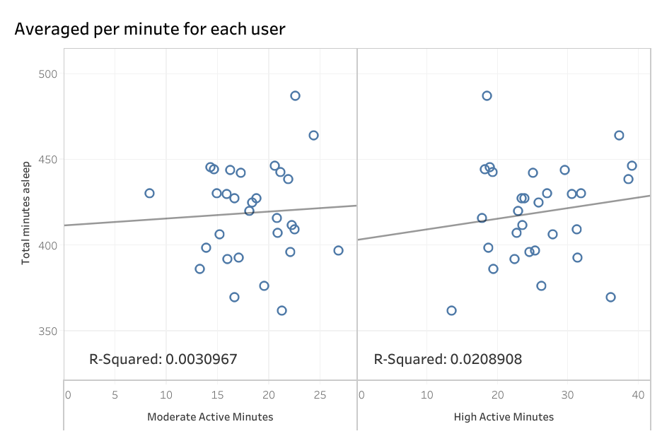
Does Activity Affect Sleep?
Sleep vs Moderate Activity: no correlation (R² ≈ 0.00)
Sleep vs High Activity: very weak correlation (R² ≈ 0.02)
Conclusion:
Sleep duration is largely independent of prior‑day activity

Slide 14
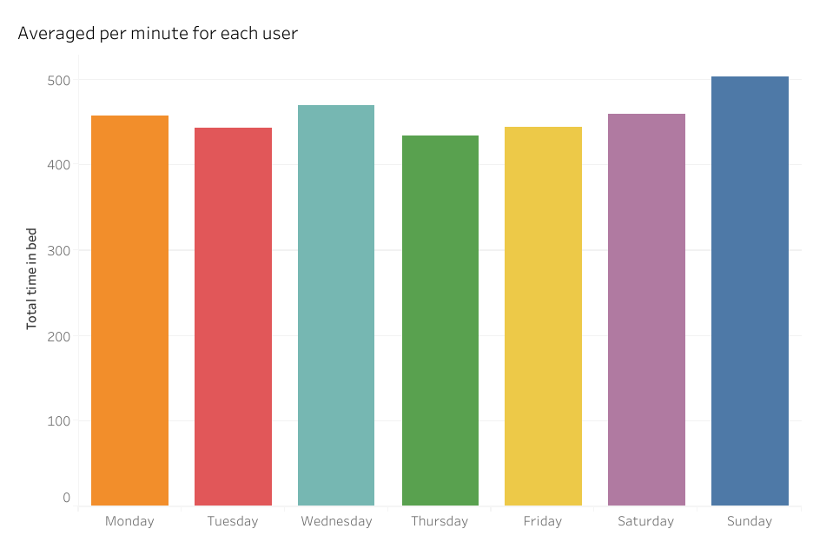
Time in Bed by Day
Longest time in bed on Sundays
Slight mid‑week increase (Wednesday)
Interpretation:
Likely reflects recovery and accumulated fatigue

Slide 15
Key Takeaways
METs and Intensity are core drivers of energy expenditure
Heart Rate is informative but less reliable
Activity follows strong daily and weekly patterns
Sleep duration shows no strong linear link to activity
Overall conclusion:
Fitbit data models physical activity effectively, prioritizing observable movement over individual physiological variability.

